Slide 1

SimpliPark
Finding Parking should not be as hard as learning how to park
Notes:
Hello friends, we are SimpliPark, consisting of Kane, Wei Kang, Qi Rong and Ken. Our mission is to make finding parking easier than learning how to park.

Slide 2
01
Problem Statement

Slide 3
Problem Statement: Q2
HDB manages many car parks and equipment that supports the operations of the car park which are visited by unique motorists. It is not possible for HDB to deploy staff/maintenance teams to every car park, due to the sheer number of car parks and equipment. For drivers, they face many problems finding empty parking spaces with drivers needing to drive around aimlessly in hopes of finding a carpark with empty lots.
Notes:
We chose the second question and we have also identified an additional problem which is that drivers may face problems with parking and need to drive around aimlessly till they find a carpark.

Slide 4
02
Solution & Desired Outcome

Slide 5
Solution
Residents can rely on SimpliPark to more easily find car parks with empty lots.
Additionally, residents are also allowed to take ownership of their estate’s well-being by allowing them to report any problems within their neighborhood swiftly and easily with the click of a button.

Slide 6
03
App Features

Slide 7
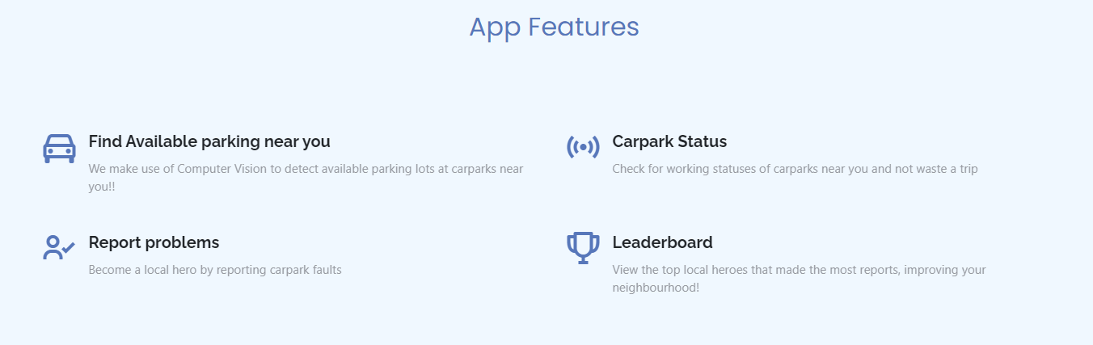
Main Features

Slide 8
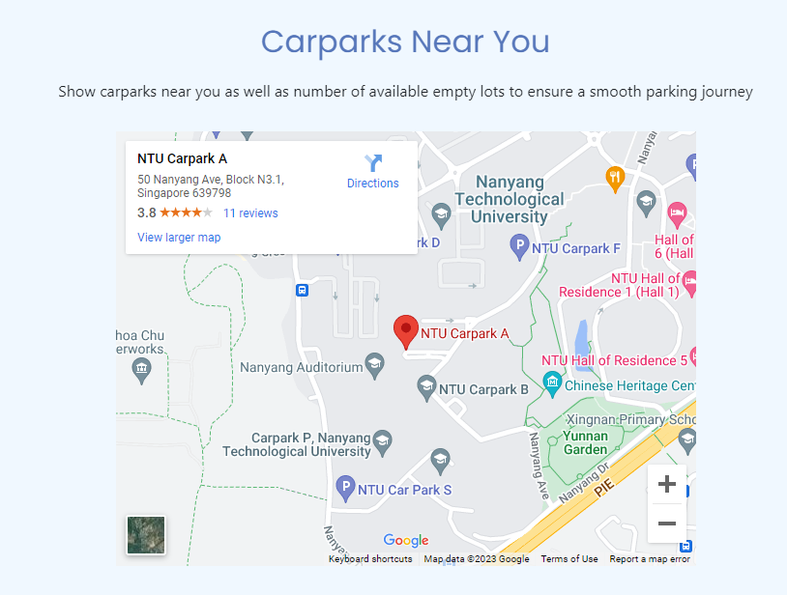
Main Features
Notes:
This page shows the carparks near your location

Slide 9
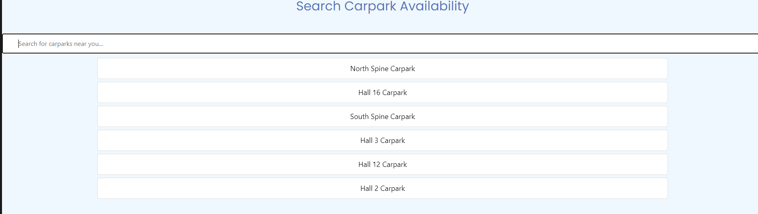
Main Features
Notes:
Search for carpark availibility

Slide 10
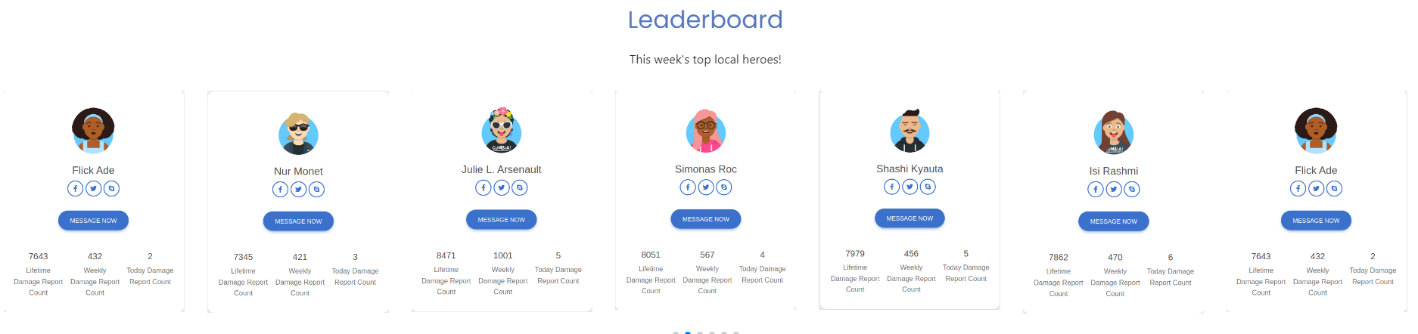
Main Features
Notes:
Leaderboard for top contributors

Slide 11
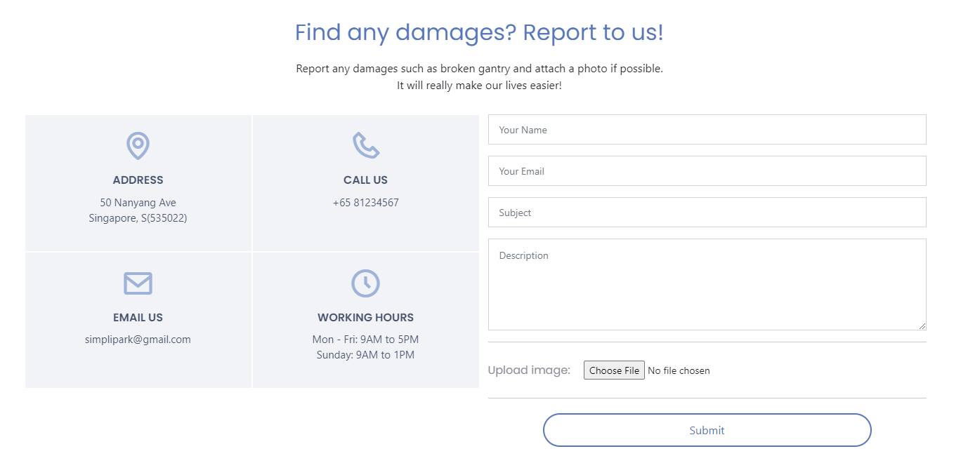
Main Features
Notes:
Report damages for the carpark gantry

Slide 12
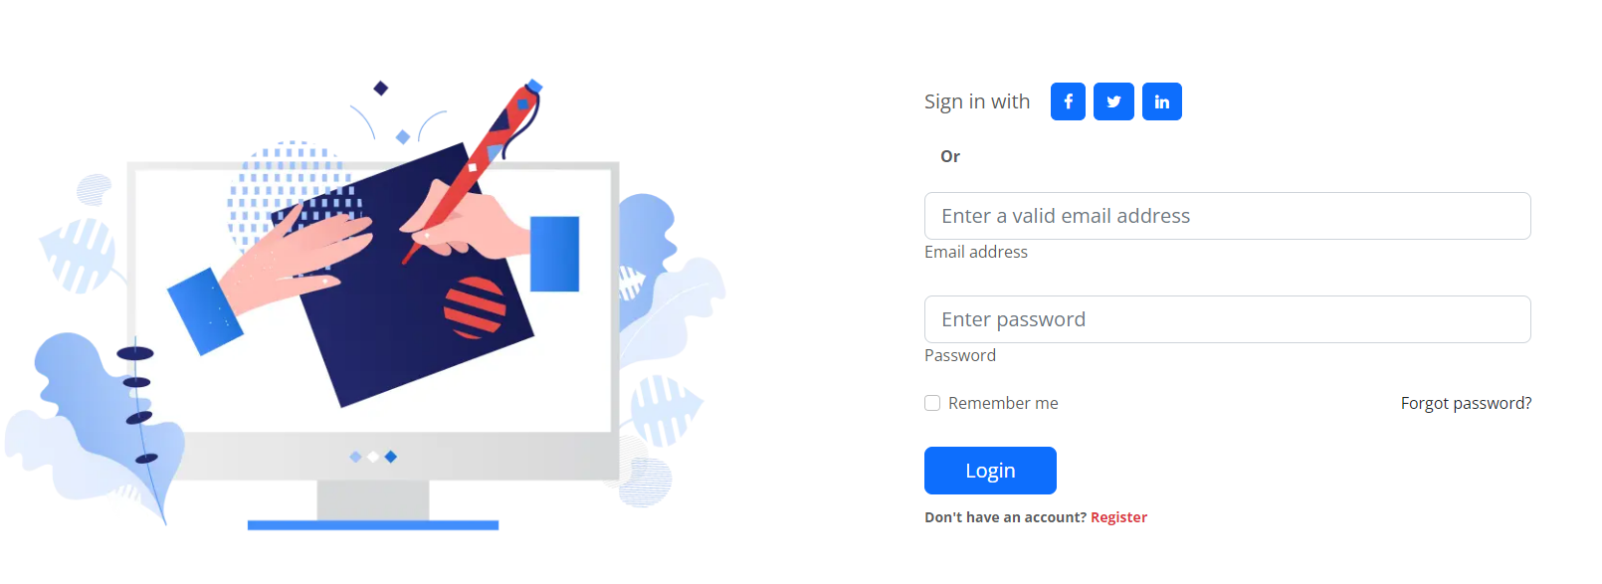
Main Features
Notes:
Create account for the web app

Slide 13
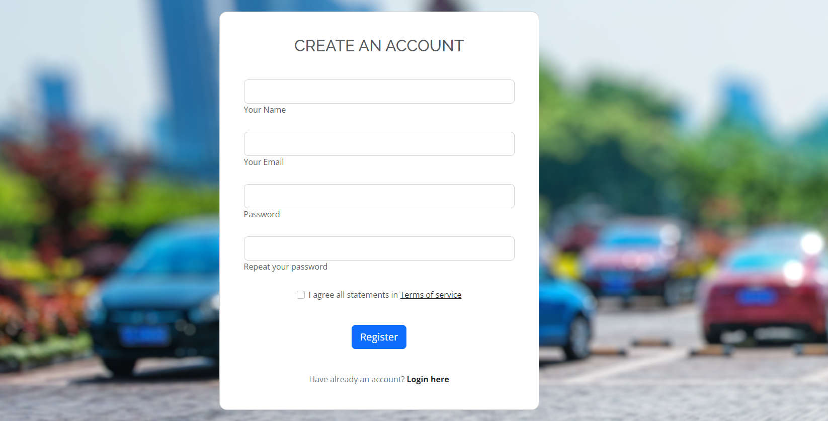
Main Features

Slide 14
Web App Demonstration
Notes:
Now to demonstrate our web app

Slide 15
04
Future Plans

Slide 16
Future Plans
SimpliPark MOBILE
Reward System
We intend to build SimpliPark Mobile that leverages on our web application for ease of use by drivers on the road.
Collaborate with HDB to provide incentives to motivate users to use the app.
Rewards can include free parking vouchers etc.
Notes:
We plan to make a mobile app in the future and include a rewards system to incentivise users

